Slide 1

EM team
www.Bridging To Easier Life.com

Slide 2
EM team members
Mohamed magdy
Eslam walid

Slide 3
Introduction

Slide 4
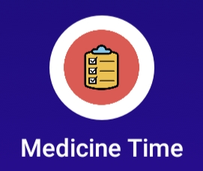
Our application
This medicine reminder is a simple smartphone app, and one that can help manage numerous people’s medications thanks to multiple profiles. It also tracks your prescriptions and reminds you when it’s time for a refill.
Meditime is a free app for Android and has received four and a half stars on their respective app stores

Slide 5
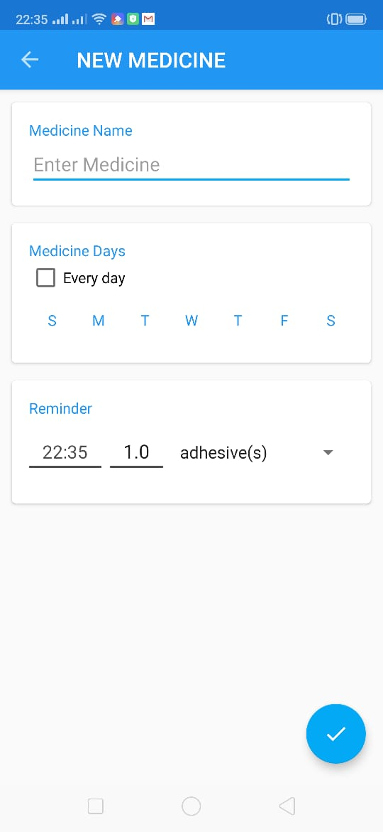
What our application aims to?
Add the desired medicine
Choose the proper time for taking it
How frequently are you taking it

Slide 6
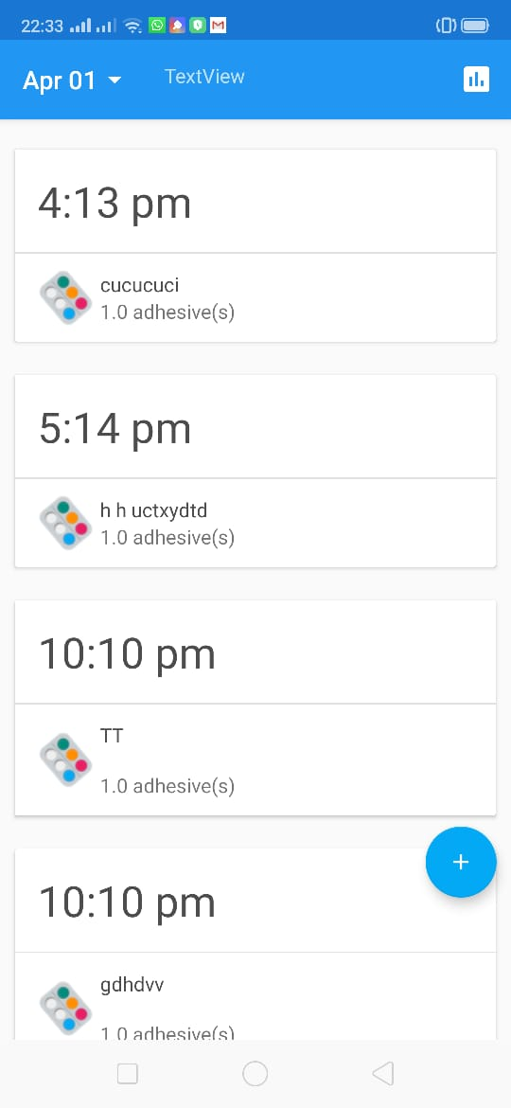
Additional properties
See the history of the taken medicine
See if you took your medicines in the right time

Slide 7
What our website aims to
Bridging the gap between disabilities and technology through suggesting apps form all different disabilities
and teaching essential skills
e.g.
conversation
Writing
reading
speech

Slide 8
Other uses
Teaching them to interact with everyday & AT devices
Mobility
hearing aids devices
Cognitive aids
computer software
Hardware
essential tools

Slide 9









Our web site suggest apps for different disabilities :
Sight problem apps
Physical problem apps
Hearing aids app

Slide 10
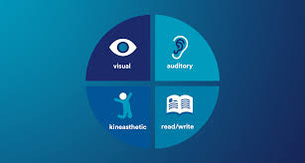


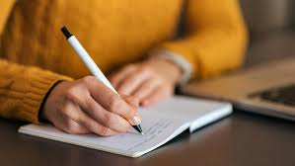
Affording essential skills through various methods of learning
Reading skills
Writing skills
Conversation skils

Slide 11
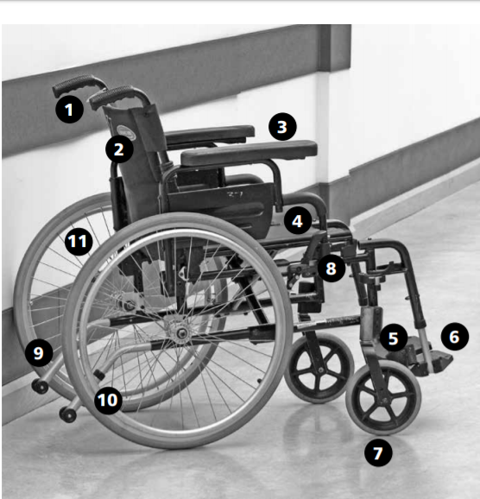
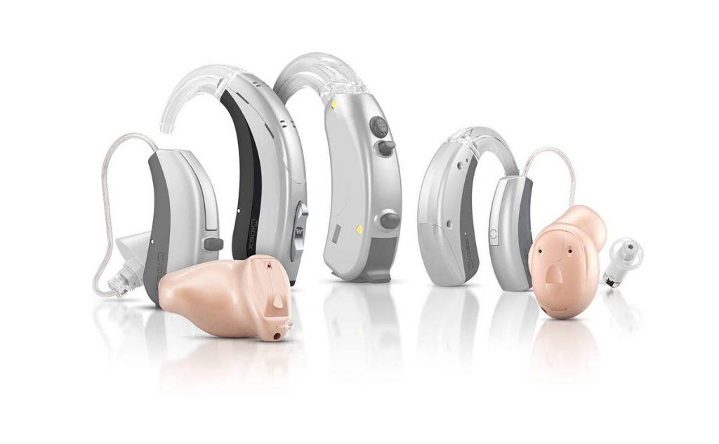
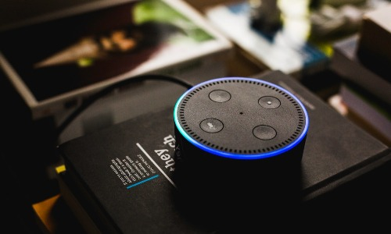
How to interact with devices that make your life easier
Mobility aids
Computer software and hardware
Hearing aids devices

Slide 12


Also tools and cognitive aids
Every day tools
Cognitive Aids

Slide 13
Thank you

Slide 14
Any questions ?

